Slide 1

Apex Institute of Technology
Department of Computer Science & Engineering
Data Mining and Warehousing
(CSF-334)
Dr Neha Agarwal
E11231
Assistant Professor
CSE(AIT), CU
DISCOVER . LEARN . EMPOWER

Slide 2
Contents to be Covered
Instance based methods
Genetic Algorithm

Slide 3
Instance-Based Methods
Instance-based learning:
Store training examples and delay the processing (“lazy evaluation”) until a new instance must be classified
Typical approaches
k-nearest neighbor approach
Instances represented as points in a Euclidean space.
Locally weighted regression
Constructs local approximation
Case-based reasoning
Uses symbolic representations and knowledge-based inference

Slide 4
The k-Nearest Neighbor Algorithm
All instances correspond to points in the n-D space.
The nearest neighbor are defined in terms of Euclidean distance.
The target function could be discrete- or real- valued.
For discrete-valued, the k-NN returns the most common value among the k training examples nearest to xq.
Vonoroi diagram: the decision surface induced by 1-NN for a typical set of training examples.
_
.
_
_
.
+
_
.
+
.
.
_
xq
+
_
.
+

Slide 5
Discussion on the k-NN Algorithm
The k-NN algorithm for continuous-valued target functions
Calculate the mean values of the k nearest neighbors
Distance-weighted nearest neighbor algorithm
Weight the contribution of each of the k neighbors according to their distance to the query point x_{q}
giving greater weight to closer neighbors
Similarly, for real-valued target functions
Robust to noisy data by averaging k-nearest neighbors
Curse of dimensionality: distance between neighbors could be dominated by irrelevant attributes.
To overcome it, axes stretch or elimination of the least relevant attributes.

Slide 6
Case-Based Reasoning
Also uses: lazy evaluation + analyze similar instances
Difference: Instances are not “points in a Euclidean space”
Example: Water faucet problem in CADET (Sycara et al’92)
Methodology
Instances represented by rich symbolic descriptions (e.g., function graphs)
Multiple retrieved cases may be combined
Tight coupling between case retrieval, knowledge-based reasoning, and problem solving
Research issues
Indexing based on syntactic similarity measure, and when failure, backtracking, and adapting to additional cases

Slide 7
Remarks on Lazy vs. Eager Learning
Instance-based learning: lazy evaluation
Decision-tree and Bayesian classification: eager evaluation
Key differences
Lazy method may consider query instance xq when deciding how to generalize beyond the training data D
Eager method cannot since they have already chosen global approximation when seeing the query
Efficiency: Lazy - less time training but more time predicting
Accuracy
Lazy method effectively uses a richer hypothesis space since it uses many local linear functions to form its implicit global approximation to the target function
Eager: must commit to a single hypothesis that covers the entire instance space

Slide 8
Genetic Algorithms
GA: based on an analogy to biological evolution
Each rule is represented by a string of bits
An initial population is created consisting of randomly generated rules
e.g., IF A₁ and Not A₂ then C₂ can be encoded as 100
Based on the notion of survival of the fittest, a new population is formed to consists of the fittest rules and their offsprings
The fitness of a rule is represented by its classification accuracy on a set of training examples
Offsprings are generated by crossover and mutation

Slide 9
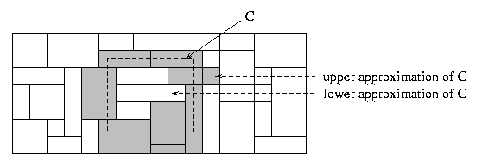
Rough Set Approach
Rough sets are used to approximately or “roughly” define equivalent classes
A rough set for a given class C is approximated by two sets: a lower approximation (certain to be in C) and an upper approximation (cannot be described as not belonging to C)
Finding the minimal subsets (reducts) of attributes (for feature reduction) is NP-hard but a discernibility matrix is used to reduce the computation intensity

Slide 10
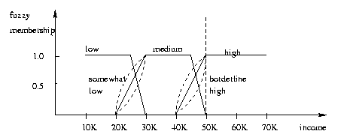
Fuzzy Set Approaches
Fuzzy logic uses truth values between 0.0 and 1.0 to represent the degree of membership (such as using fuzzy membership graph)
Attribute values are converted to fuzzy values
e.g., income is mapped into the discrete categories {low, medium, high} with fuzzy values calculated
For a given new sample, more than one fuzzy value may apply
Each applicable rule contributes a vote for membership in the categories
Typically, the truth values for each predicted category are summed

Slide 11
Homework
Explain genetic algorithm.
Discuss different instance based classification methods.

Slide 12
References
TEXT BOOKS
Introduction to Data Mining, Tan, Steinbach and Vipin Kumar, Pearson Education, 2016
REFERENCE BOOKS
Data Mining: Concepts and Techniques, Pei, Han and Kamber, Elsevier (2nd edition)
Journals
https://www.sciencedirect.com/topics/computer-science/data-generalization

Slide 13
Thank you
Please Send Your Queries on:
e-Mail: neha.e11231@cumail.in

